Slide 1


Salary packaging Module
Payroll Team April 2015

Slide 2
Salary Packaging Module – Important Points
  Check your Base Salary displayed on the screen. This should be your latest Basic and Flexible Compensation, as given in your Salary Revision letter. Other salary components will not be displayed.
  Note that once you submit your Flexi declaration, you cannot in any way change or revert back the declaration submitted to payroll.
  If you do not submit your salary packaging before the due date, the existing salary package will be continued and accordingly the tax will be calculated.
  Employees who are in the car lease scheme are requested not to change “Car lease allowance” component amount while updating your flexible compensation plan.
  Employees to change HRA accordingly based on the revised Basic. Kindly note it is not an default function.
  Transport Allowance should be updated by the employees who are using their own transportation to commute (employees under car lease are not eligible to avail this benefit)

Slide 3
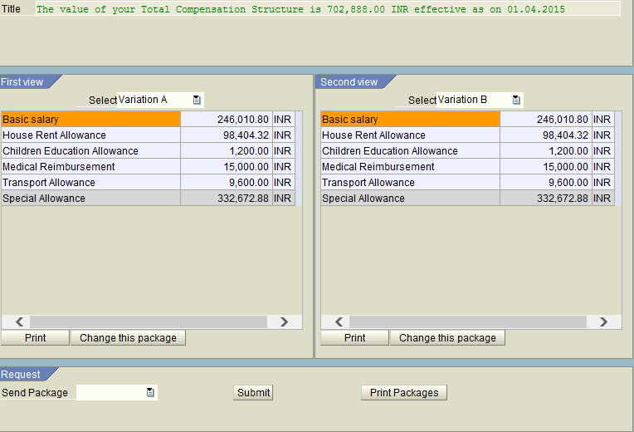
Salary Packaging Module – Screen 1
Employees to note:The Variation A and B is the system module.
You are requested to choose any one (only) of the variation to allocate the components.
Kindly make sure to choose the same variations and save the details after the changes.
Base Salary
35% of Base salary - can not be changed
Click here to Change Variation A
Click here to Change Variation B

Slide 4
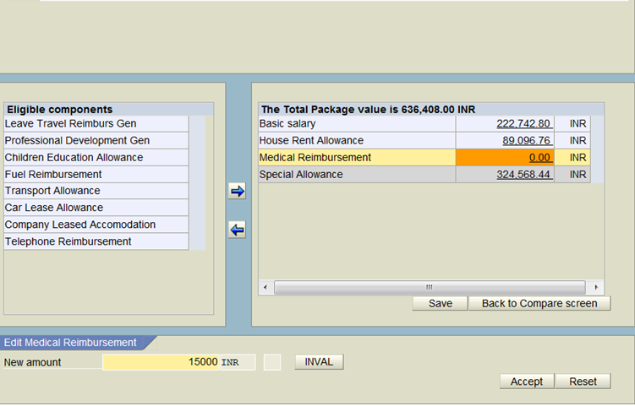
Salary Packaging Module – Screen 2
STEP 2 - You can select the desired components by using arrows.
STEP 3 - To change the value of a chosen component , click on the monetary field, Click on the field “New Amount” type the amount and click ‘Accept’
STEP 4 - When completed, click on “save” and than “back to compare screen” to continue
1. Click on the desired component
3. Click on the Monetary Field
2. Use these arrows to move the components from left to right and vice versa
4. Type the amount
5. Press Accept to change the amount or Reset to change again

Slide 5
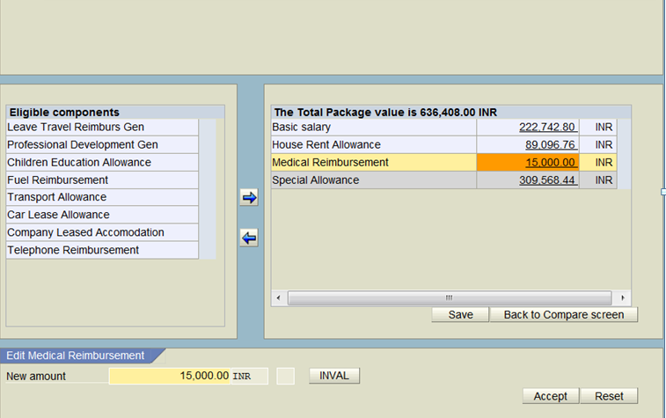
Salary Packaging Module – Screen 3
Note: - When completed, click on “save” and than “back to compare screen” to continue
6. Press Save before you press Back to Compare Screen
7. Press Back to Compare Screen to come-back & compare the variations

Slide 6
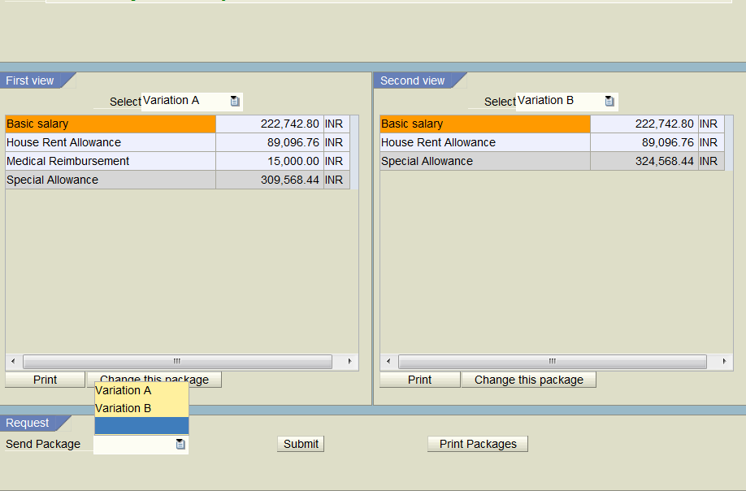
Salary Packaging Module – Screen 4
8. Select the package you have choosed and want to submit
9. Press submit to send your package to payroll

Slide 7
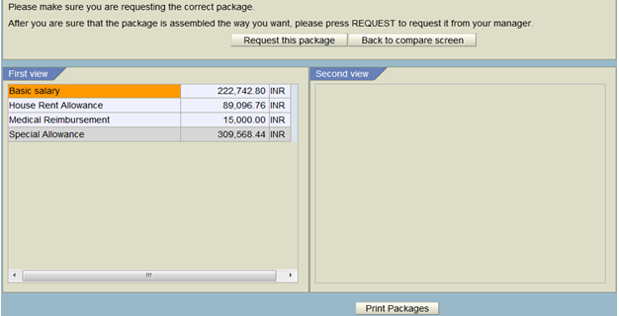
Salary Packaging Module – Screen 5
10. Click here to update the package into Payroll. This action cannot reverted and no option to change.

Slide 8
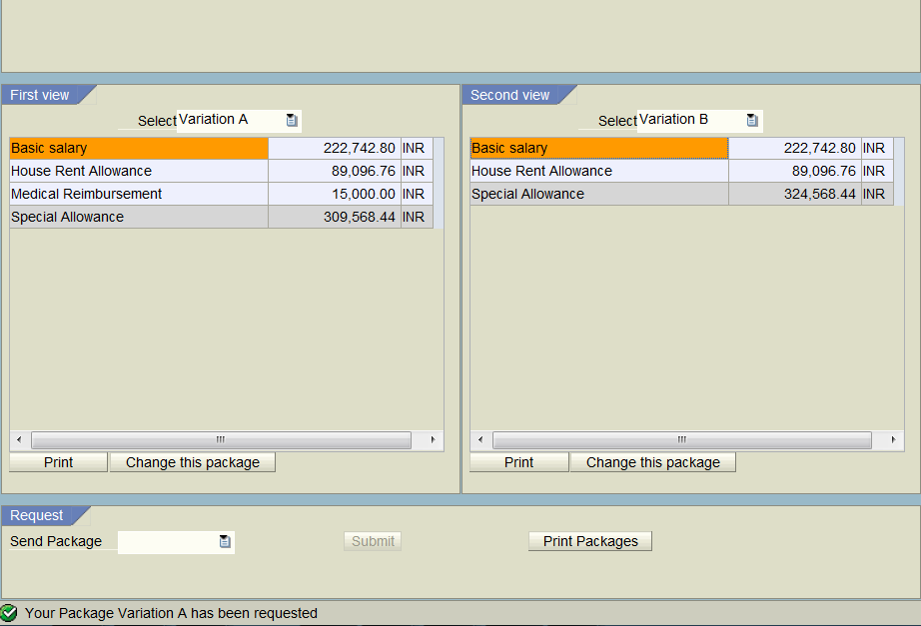
Salary Packaging Module – Screen 6
Pls check for the message below to make sure that your package has been updated to IPP
Take a screen shot of the same and save for your records to check the details when required in near future.

Slide 9
Thank You!
E-mail – hrdirectapj@sap.com

